Slide 1





STOCK MARKET FORECAST
Team : NARENKUMAR S
Email : Narenk837@gmail.com
Guide: (P.Raja, Master Trainer )
Disclaimer: The content is curated for educational purposes only.
Notes:
Slides: Prepare a short slide deck (10-12 slides) summarizing the project objectives, methodology, and key results.

Slide 2
OUTLINE
Abstract
Problem Statement
Proposed System/Solution
Algorithm & Deployment
GitHub Link
Project Demo(photos / videos)
Conclusion
Future Scope
References

Slide 3
Abstract
Algorithmic trading uses computer programs to automatically make trades when certain conditions are met. This allows for fast, accurate trades with high volume and less human error. While it can be complex to set up, it helps traders achieve better results in the stock market. Success depends on factors like market conditions, quality of the algorithm, data analysis, and risk management. Fast execution is a major benefit, as it allows traders to quickly respond to price changes. Profits vary widely based on the strategy and market conditions. Common strategies include arbitrage, rebalancing, mean reversion, and market timing.

Slide 4
Problem Statement
Algorithmic trading has revolutionized financial markets by automating the trading process and allowing for faster execution of trades. However, challenges such as latency, technical issues, and the risk of overfitting in trading models need to be addressed. The problem we aim to solve is improving trade execution efficiency while minimizing market risks and system failures in algorithmic trading systems.

Slide 5
Proposed Solution
To solve the problem of this project will focus on designing a basic algorithmic trading system for stock market trading. It will primarily use moving average crossovers, statistical arbitrage, and trend-following strategies. While the system will be tested with historical data, real-time execution and trading across different markets are beyond the scope of this project.

Slide 6
Github project link
https://github.com/narenkumarsenthil/NAAN-MUDHAVAN-PROJECT.git
Notes:
thank you very much for joining this PPT, keep learning.
6

Slide 7
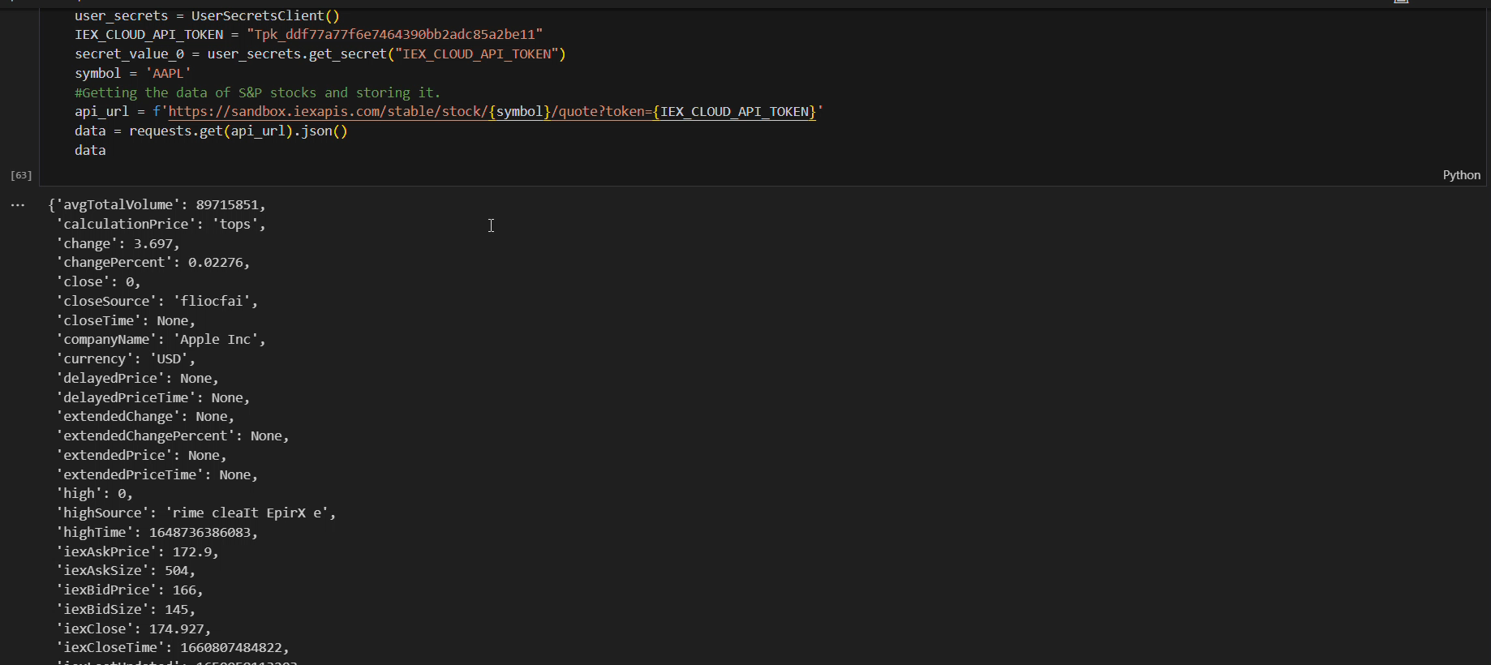
Video of Project Demo

Slide 8
Conclusion
In conclusion, sentiment analysis provides a powerful tool for understanding audience emotions and feedback by efficiently analyzing large volumes of text data. Using a combination of lexicons and machine learning models enhances accuracy, allowing businesses to gain real-time insights into customer sentiment. This analysis can guide strategic decisions, improve customer satisfaction, and foster better communication by identifying and addressing trends in audience sentiment.

Slide 9
Future Scope
Real-time
adaptive
multilingual
predictive
scalable

Slide 10
Thank you!
Notes:
thank you very much for joining this PPT, keep learning.
10

